Slide 1
Understanding and Simplifying One-Shot Architecture Search
Gabriel Bender, Pieter-Jan Kindermans, Barret Zoph, Vijay Vasudevan, Quoc Le
Prepared by Jie Yong Shin
22th Aug 2023

Slide 2
Highlights
Does the temperature expand the search space?
Why doesn’t DARTS use every operation in the end?
How about dropping out several paths?
Why the training accuracy in the search phase is always less than the training accuracy in the training phase?
Does the one-shot model really search? Or is it just randomly training?

Slide 3
Outline
Search Space of a One-Shot Model
Path Dropout
Ghost Batch Normalization
Experimental Results
Conclusion

Slide 4
Outline
One-Shot NAS Model
Search Space Design
Path Dropout
Ghost Batch Normalization
Experimental Results
Conclusion

Slide 5
One-Shot NAS Model
The four steps of a one-shot architecture search :
Design a search space that allows us to represent a wide variety of architectures using a single one-shot model.
A one-shot model chooses one or two operations for each edge.
Train the one-shot model to make it predictive of the validation accuracies of the architectures.
Evaluate candidate architectures on the validation set using the pre-trained one-shot model.
Re-train the most promising architectures from scratch and evaluate their performance on the test set.

Slide 6
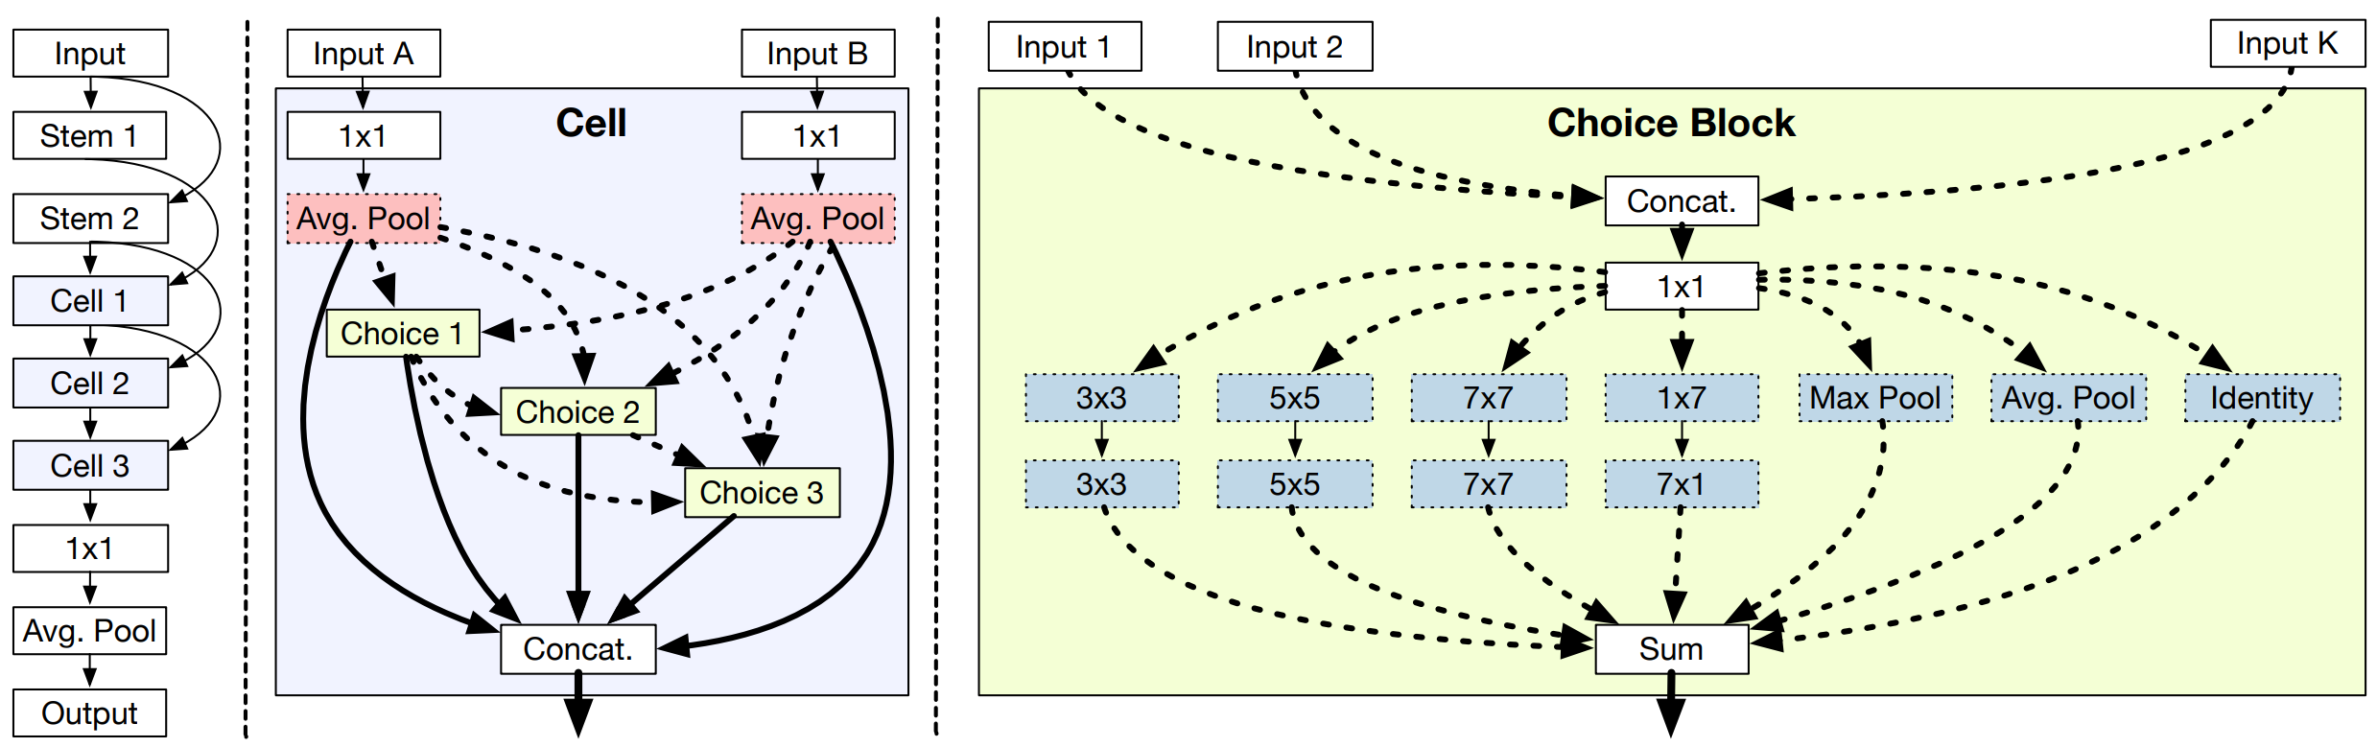
One-Shot NAS Model

Slide 7
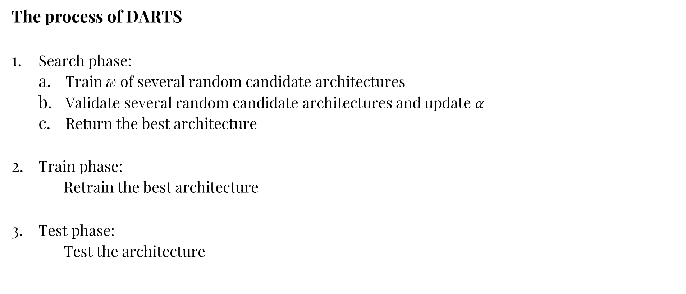
One-Shot NAS Model
The process of DARTS
Search phase:
Train w of several random candidate architectures
Validate several random candidate architectures and update $α$
Return the best architecture
Train phase:
Retrain the best architecture
Test phase:
Test the architecture

Slide 8
Outline
One-Shot NAS Model
Search Space Design
Path Dropout
Ghost Batch Normalization
Experimental Results
Conclusion

Slide 9
Search Space Design
Competing requirements
The search space should be large and expressive enough to capture a diverse set of interesting candidate architectures.
The validation set accuracies produced by the one-shot model must be predictive of the accuracies produced by stand-alone model training.
The one-shot model must be small enough to train using limited compute resources (i.e., memory and time). The best architectures in the search space must also have competitive accuracies.

Slide 10
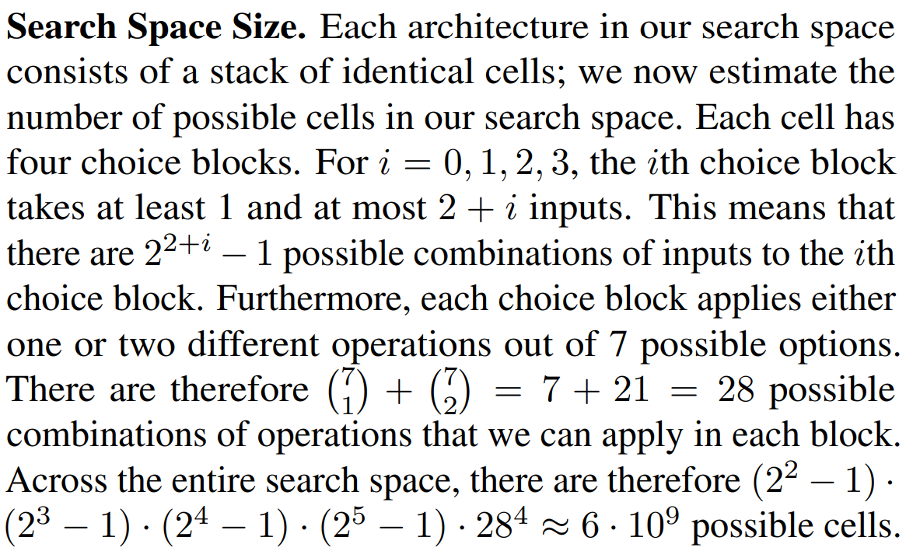
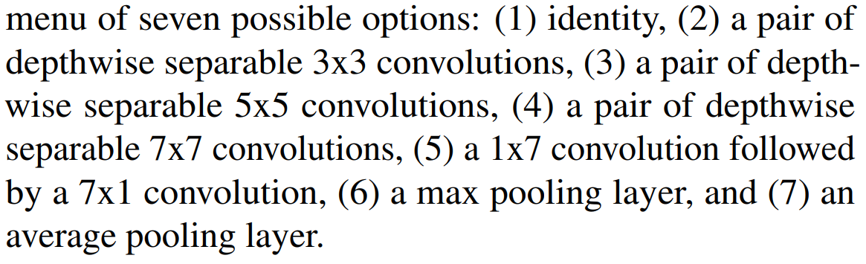
Search Space Design
Calculation of the size of search space
Temperature is included to evaluation metric.

Slide 11
Outline
One-Shot NAS Model
Search Space Design
Path Dropout
Ghost Batch Normalization
Experimental Results
Conclusion

Slide 12
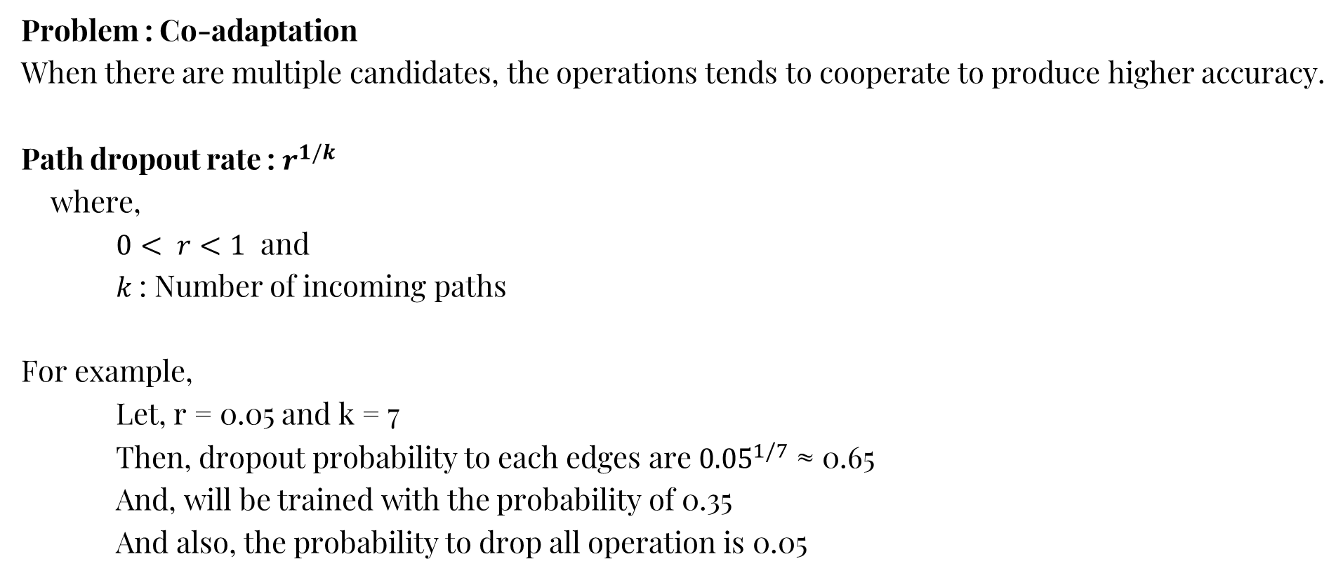
Path Dropout
Problem : Co-adaptation
When there are multiple candidates, the operations tends to cooperate to produce higher accuracy.
Path dropout rate : $r^{1/k}$
where,
$0< r<1$ and
$k$: Number of incoming paths
For example,
Let, r = 0.05 and k = 7
Then, dropout probability to each edges are ${0.05}^{1/7}$ ≈ 0.65
And, will be trained with the probability of 0.35
And also, the probability to drop all operation is 0.05

Slide 13
Outline
One-Shot NAS Model
Search Space Design
Path Dropout
Ghost Batch Normalization
Experimental Results
Conclusion

Slide 14
Ghost Batch Normalization
Problem : Unstable convergence
Removing other candidates those are not selected changes the batch statistics at each layer. Because we do not know the batch statistics for a candidate architecture in advance, batch normalization is applied exactly the same way at test phase as during training phase – computing the batch statistics on the fly.
Ghost batch – Batches in batches. Fix the dropout the same path for every ghost batch.

Slide 15
Outline
One-Shot NAS Model
Search Space Design
Path Dropout
Ghost Batch Normalization
Experimental Results
Conclusion

Slide 16
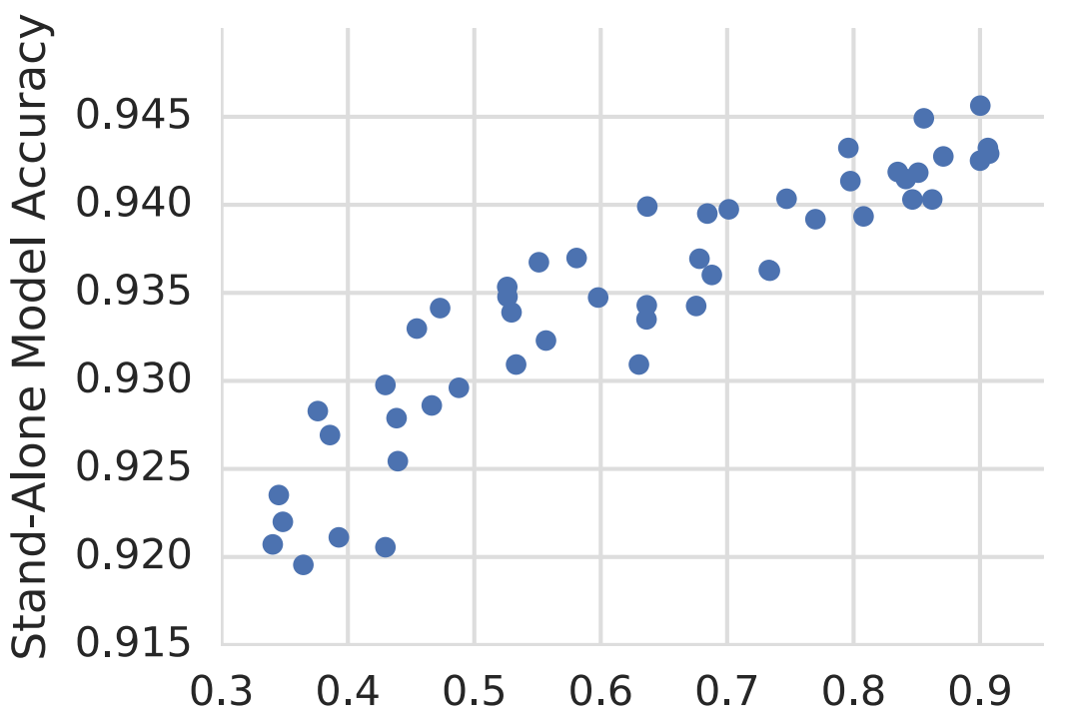
Experimental Results
Problem : The range of accuracy between stand-alone model and one-shot model are too different
Hypothesis: The most useful operations are being dropped
One-Shot Model Accuracy

Slide 17
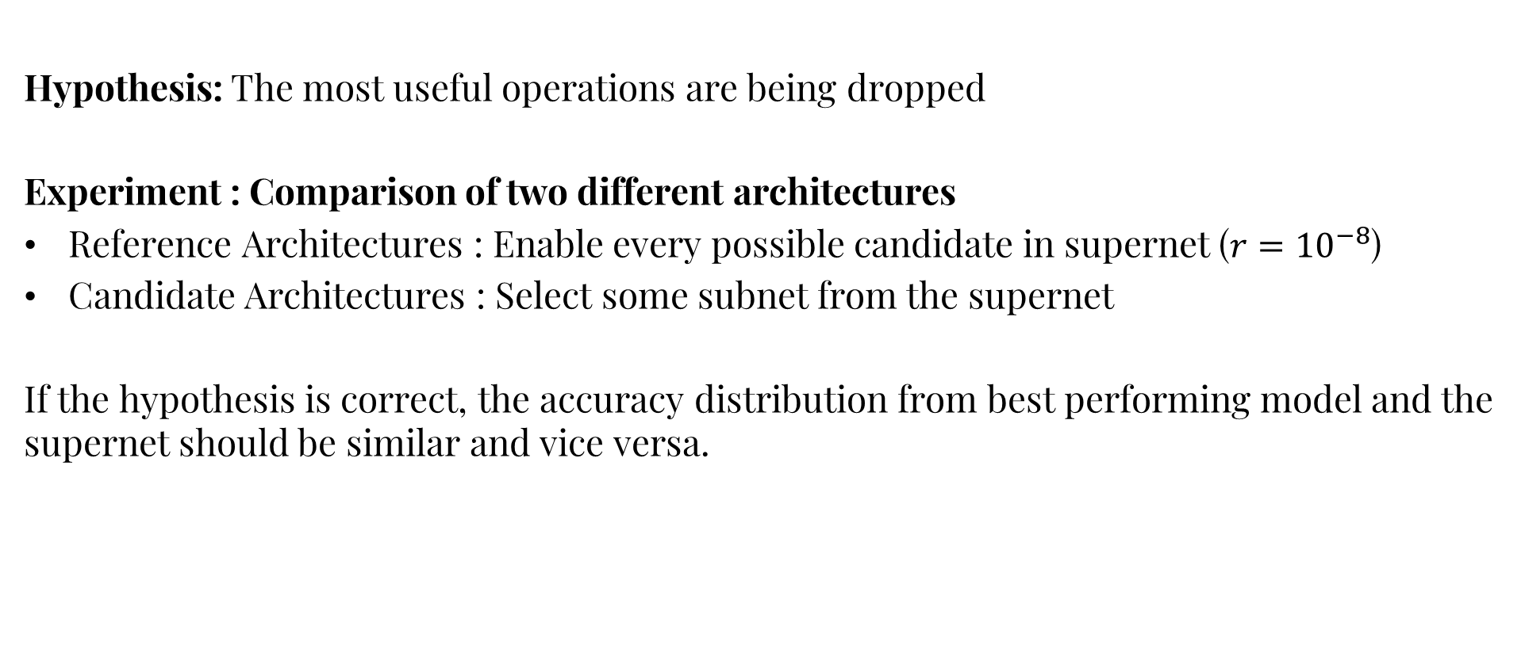
Experimental Results
Hypothesis: The most useful operations are being dropped
Experiment : Comparison of two different architectures
Reference Architectures : Enable every possible candidate in supernet ($r={10}^{−8}$)
Candidate Architectures : Select some subnet from the supernet
If the hypothesis is correct, the accuracy distribution from best performing model and the supernet should be similar and vice versa.

Slide 18
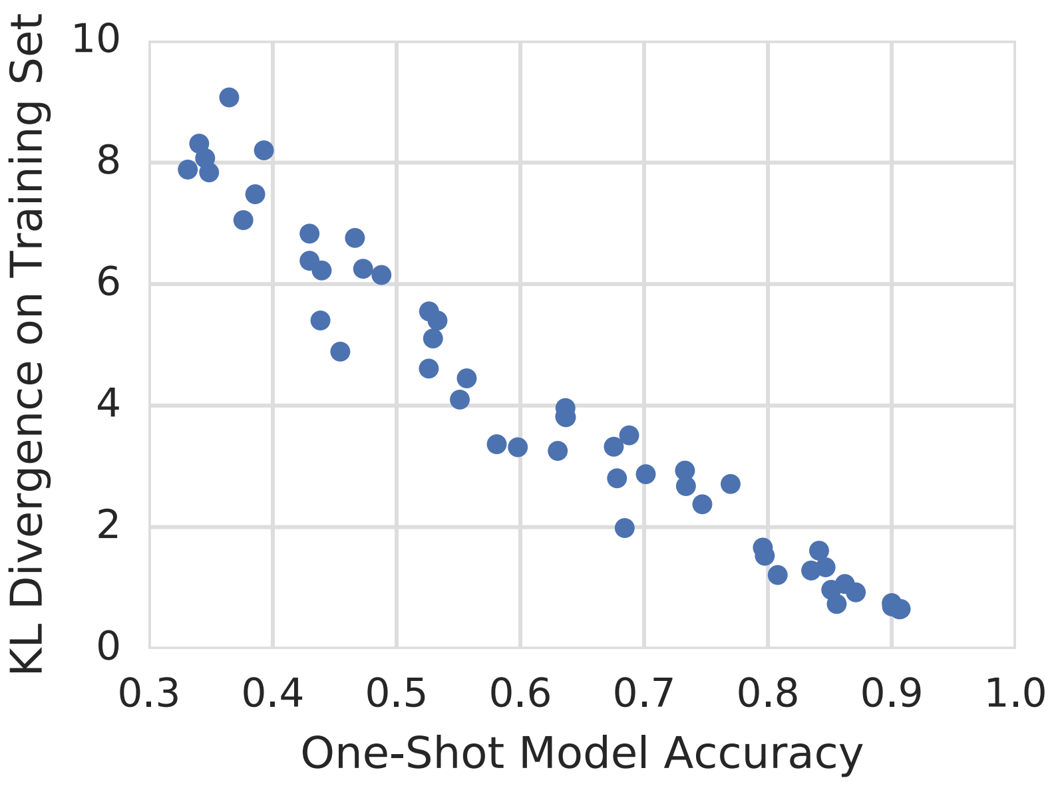
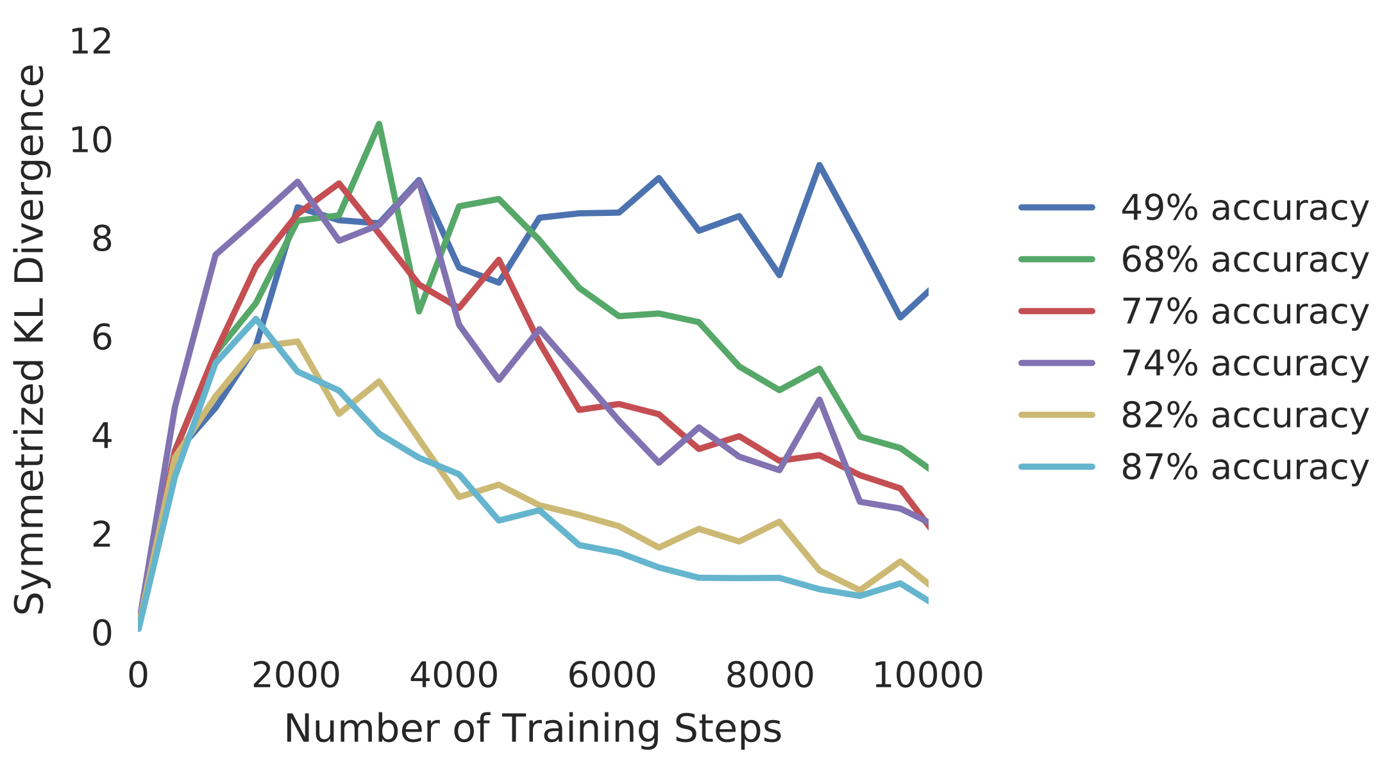
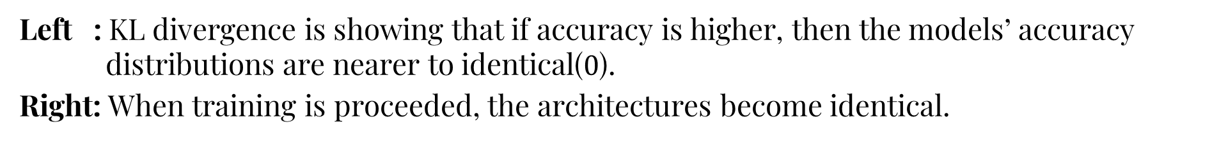
Experimental Results
Left : KL divergence is showing that if accuracy is higher, then the models’ accuracy distributions are nearer to identical($0$).
Right: When training is proceeded, the architectures become identical.

Slide 19
Outline
One-Shot NAS Model
Search Space Design
Path Dropout
Ghost Batch Normalization
Experimental Results
Conclusion

Slide 20
Conclusion
Does the temperature expand the search space?
Temperature is not added to the search space
Why doesn’t DARTS use every operation in the end?
NAS algorithm must improve one of these: memory or time
How about dropping out several paths?
Path Dropout
Why the training accuracy in the search phase is always less than the training accuracy in the training phase?
Elimination of a good operations
Does the one-shot model really search? Or is it just randomly training?
KL divergence shows the relationship between the supernet and subnet

Slide 21
References
Gabriel Bender, Pieter-Jan Kindermans, Barret Zoph, Vijay Vasudevan, Quoc Le, “Understanding and Simplifying One-Shot Architecture Search”, https://proceedings.mlr.press/v80/bender18a.html
Barret Zoph, Quoc V. Le, “NEURAL ARCHITECTURE SEARCH WITH REINFORCEMENT LEARNING”, https://arxiv.org/abs/1611.01578
Andrew Brock, Theodore Lim, J.M. Ritchie, Nick Weston, “SMASH: One-Shot Model Architecture Search through HyperNetworks”, https://arxiv.org/abs/1708.05344

Slide 22
Thank you!
Q & A

